Slide 1
Step-by-Step Guide for Booking Equipment Using FLMS
(Video Storyboard)

Slide 2
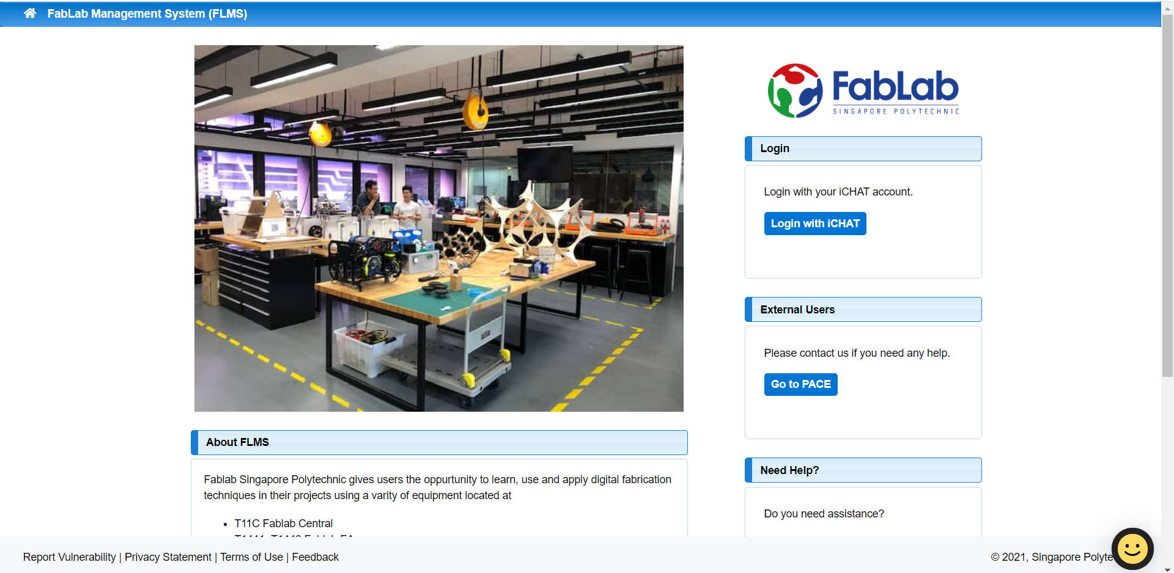
Step 1
Go to FabLab Management System and log in with your iChat account.

Slide 3
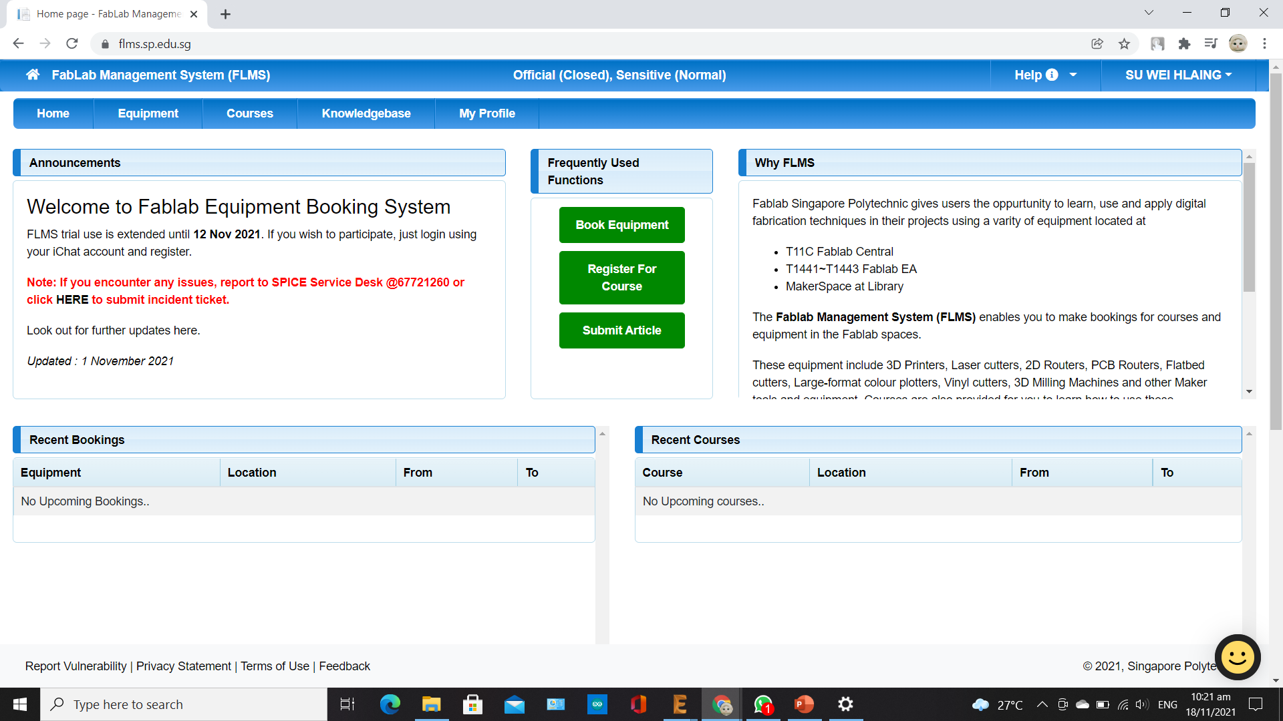
Step 2
It will take you to the FLMS “Home” page. Click “Book Equipment” to book your equipment.
Your name will
appear here.

Slide 4
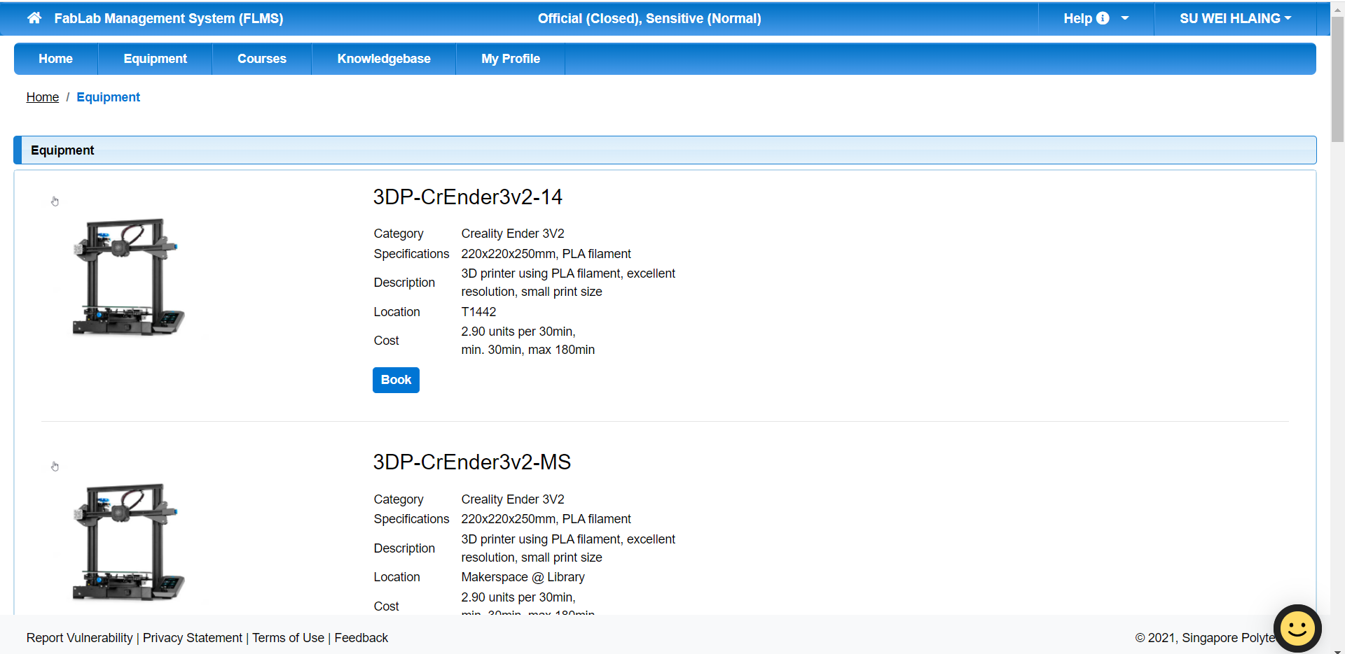
Step 3
Choose the equipment from the facility you desire. Take note of the location of the equipment. You can see it in the description of the equipment. After making sure of the equipment and location, click “Book”.

Slide 5
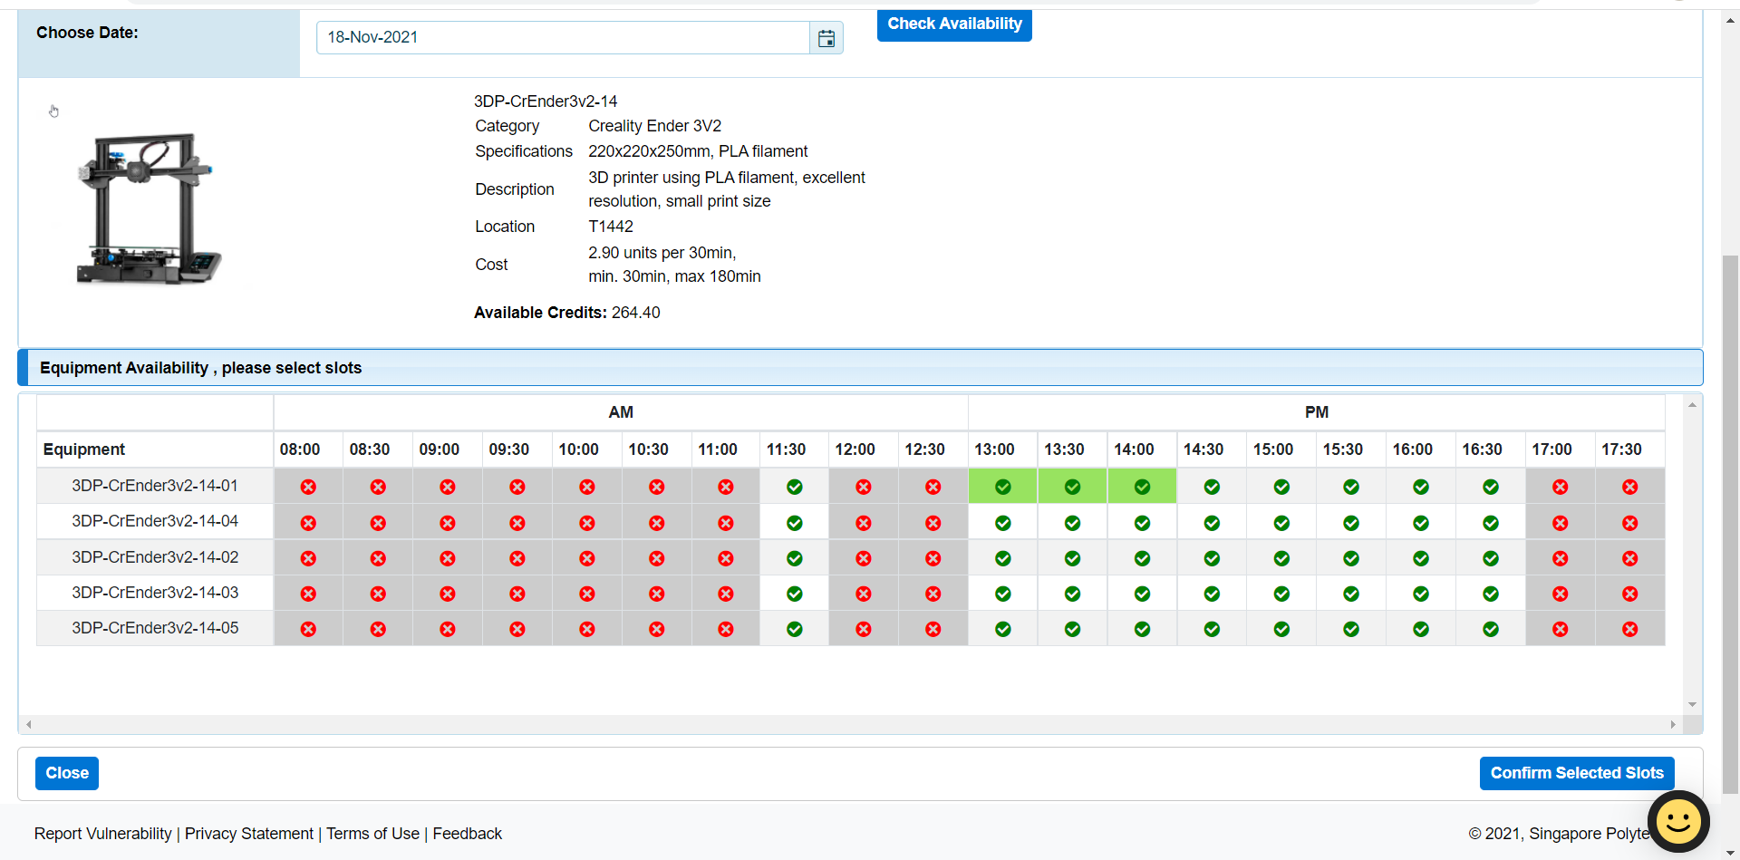
Step 4
Choose the date and time. Take note of the max duration you can use the equipment. Choose the equipment number you would like to use and choose the available time slot. If you are satisfied with you selection, click “Confirm Selected Slots” to confirm your booking.

Slide 6
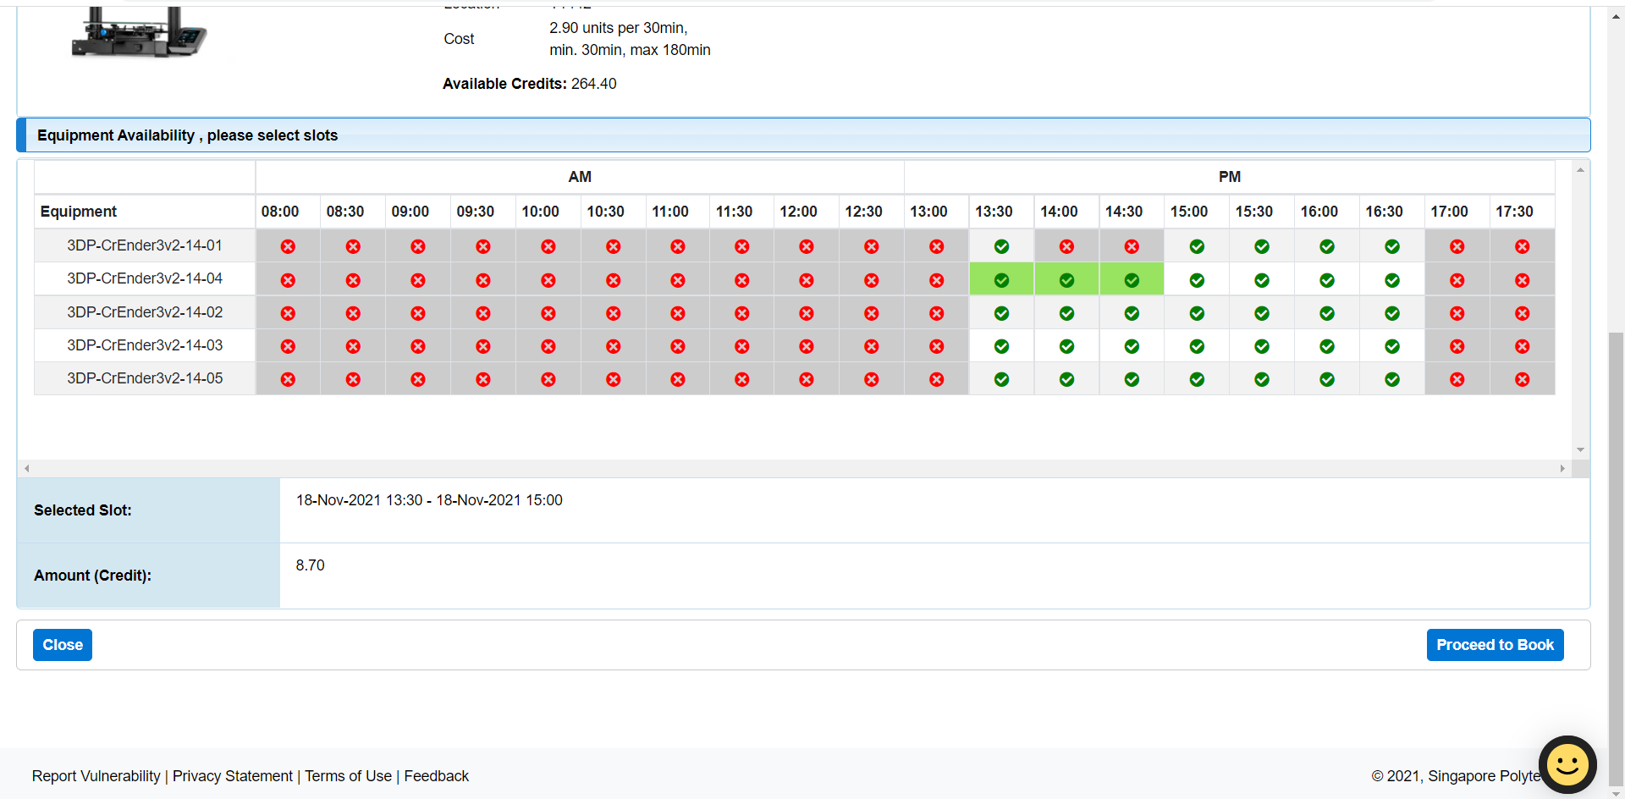
Step 5
A table will pop-up. Check your date, time and credit. After you have confirmed the details, click “Proceed to Book”.

Slide 7
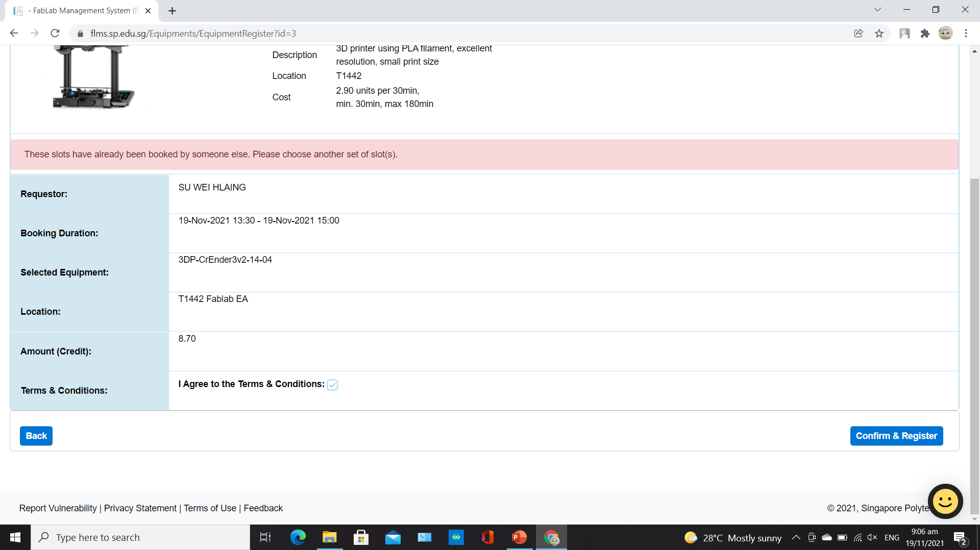
Step 6
You will see a table. Tick the box “I Agree to the Terms & Conditions” then click “Confirm & Register”.

Slide 8
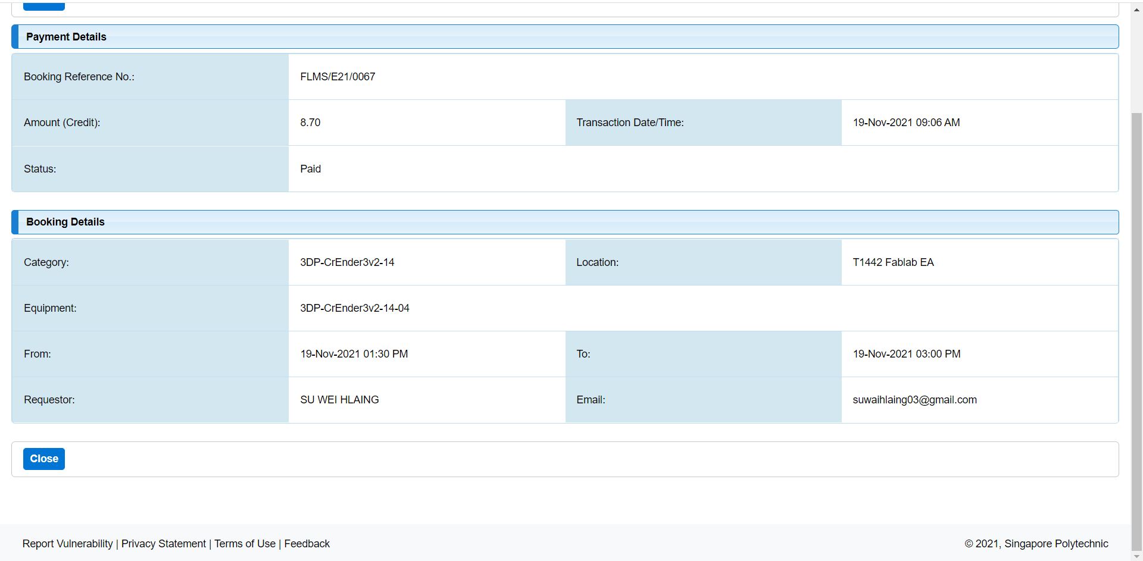
Step 7
The next page will show you the booking details. Click “Close”.

Slide 9
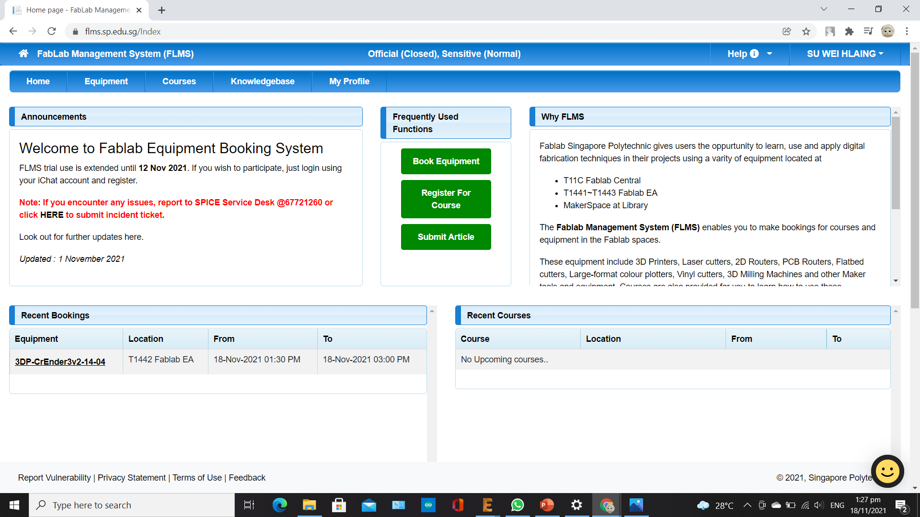
Step 8
You will be taken back to the “Home” screen. You will see your booking schedule under “Recent Bookings” at the bottom left of the page.

Slide 10
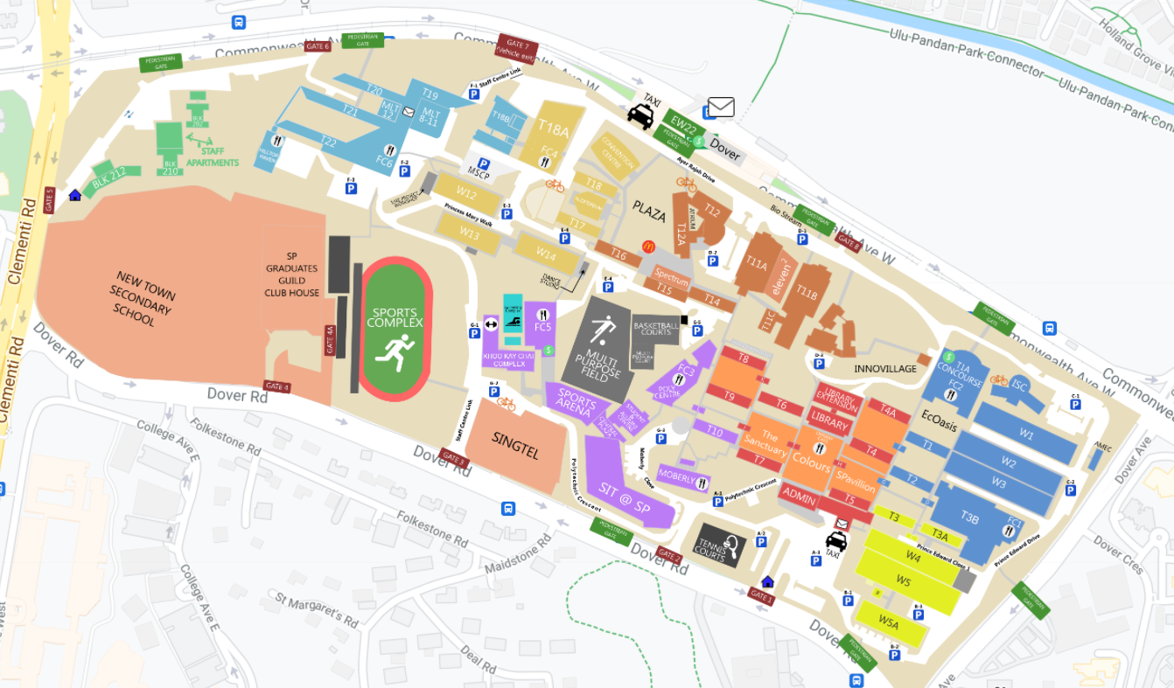
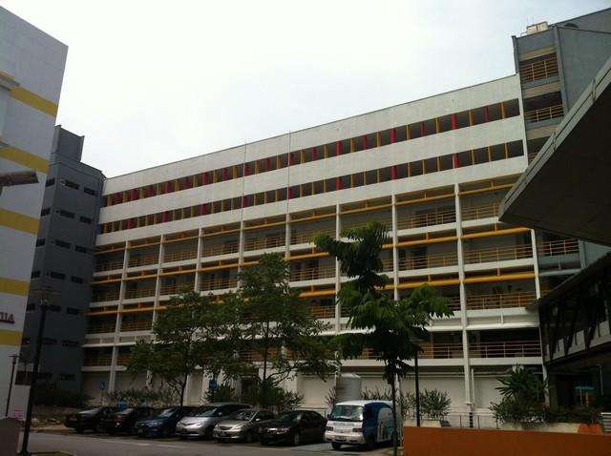
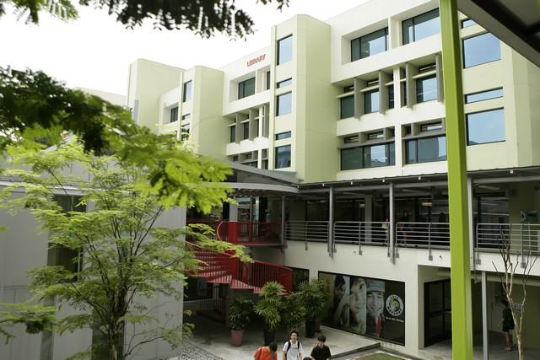
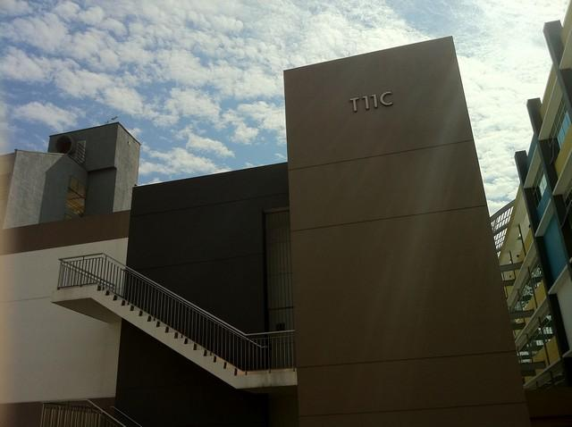
Step 9
Go to the location of the booked equipment.

Slide 11
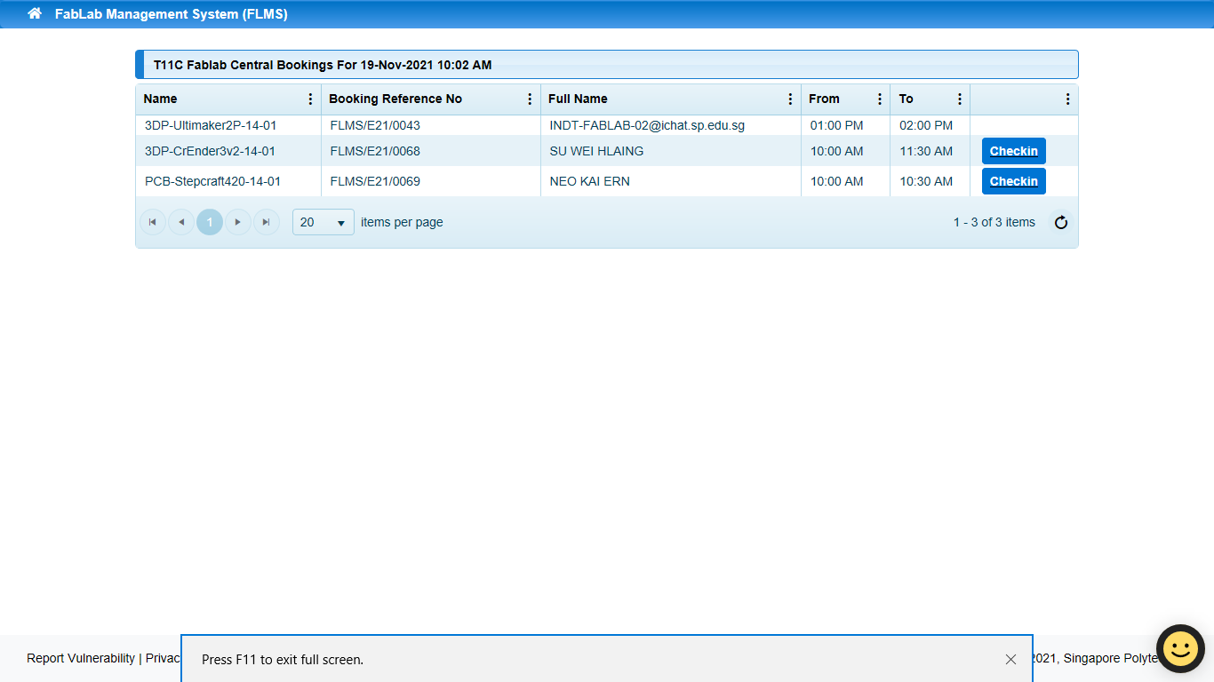
Step 9
When you reached your destination, find the lab computer and find your name from the list then click “Checkin”.

Slide 12
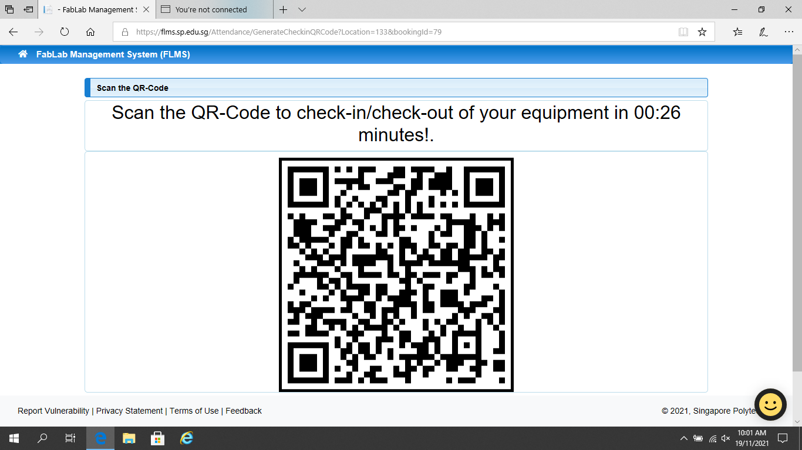
Step 10
A QR code will appear on the screen. Scan the code with your mobile phone.

Slide 13
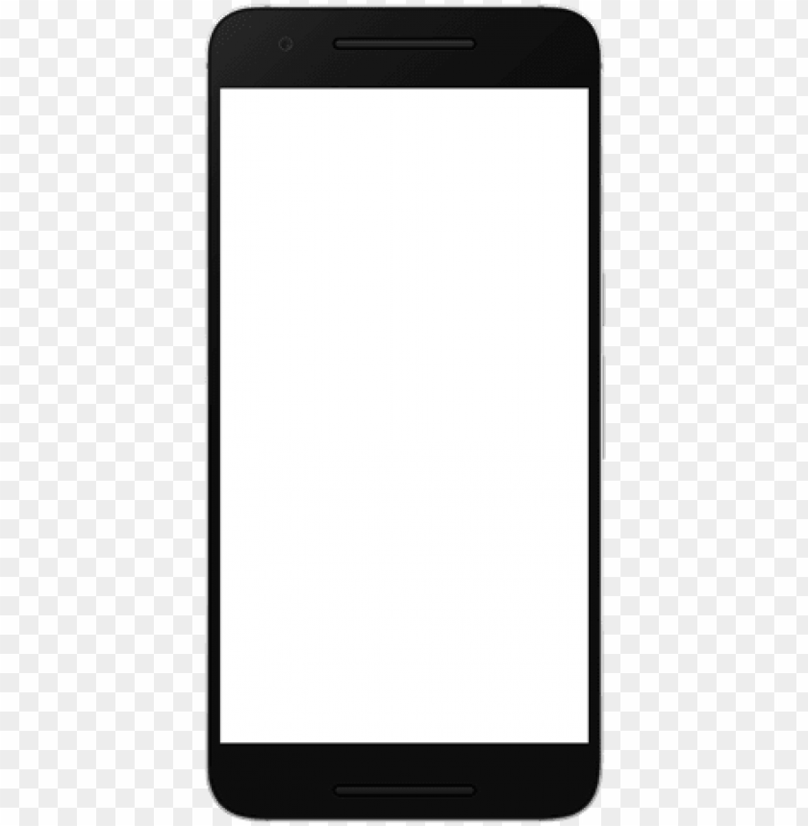
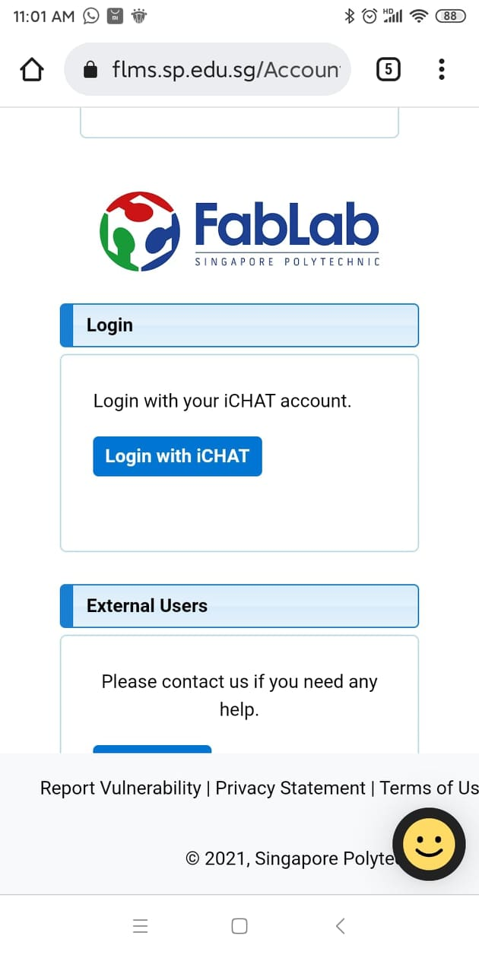
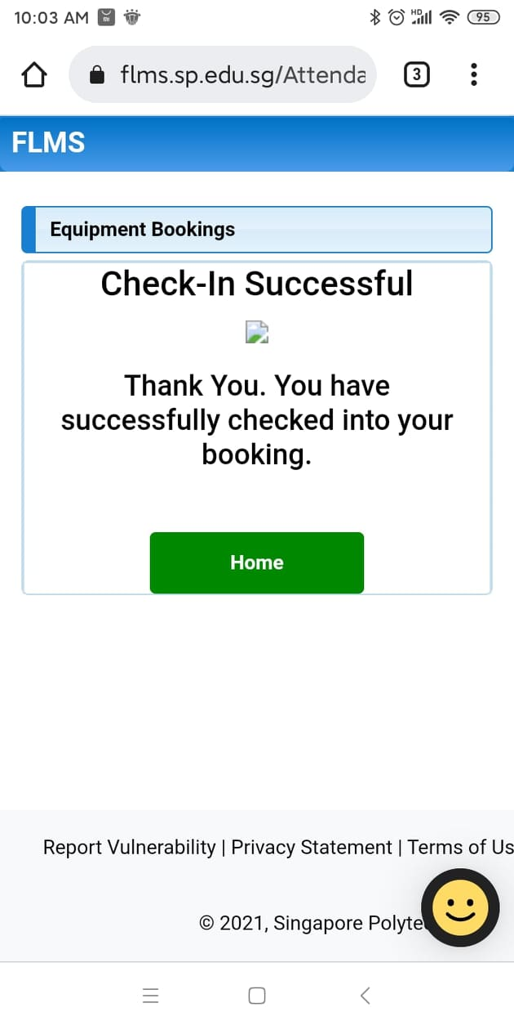
Step 11
You will be directed to FLMS login page. Login with you iChat account. Then, you will be successfully checked in.
Now you are free to use the equipment.

Slide 14
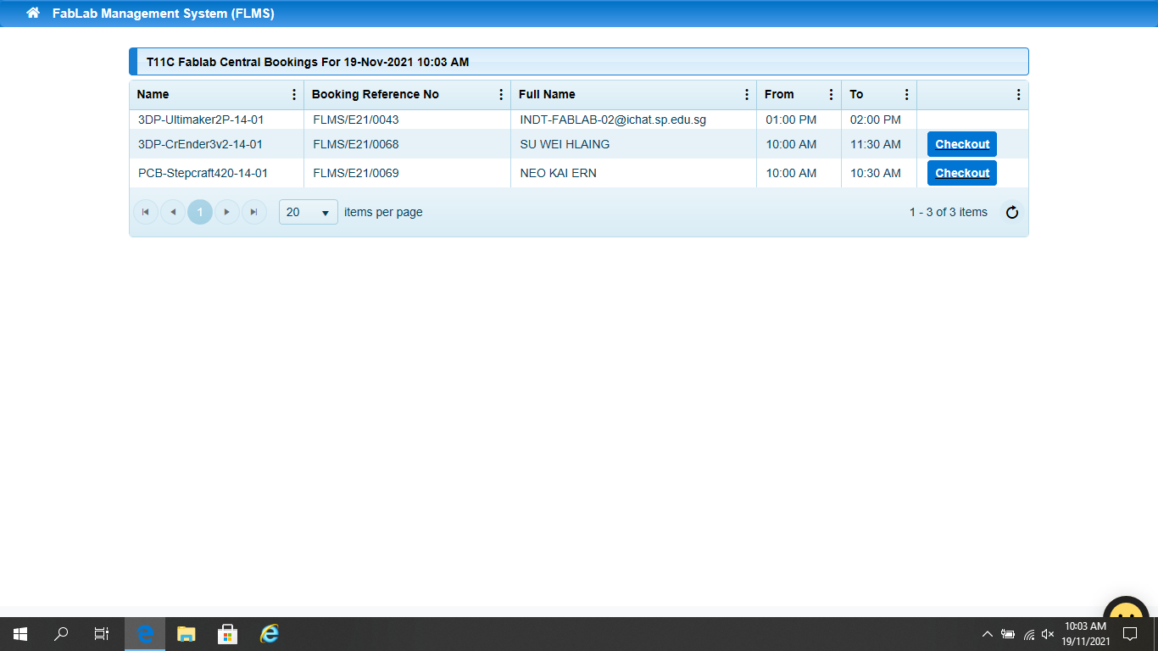
Step 10
After the equipment has been used, you will need to checkout. Repeat the process for checking in. (Step 9 to 11)
This time, the box will show “Checkout”.

Slide 15

Step 11
If you see this on your mobile, you have checked out successfully. You can now leave the facility.

Slide 16
How to cancel your booking

Slide 17
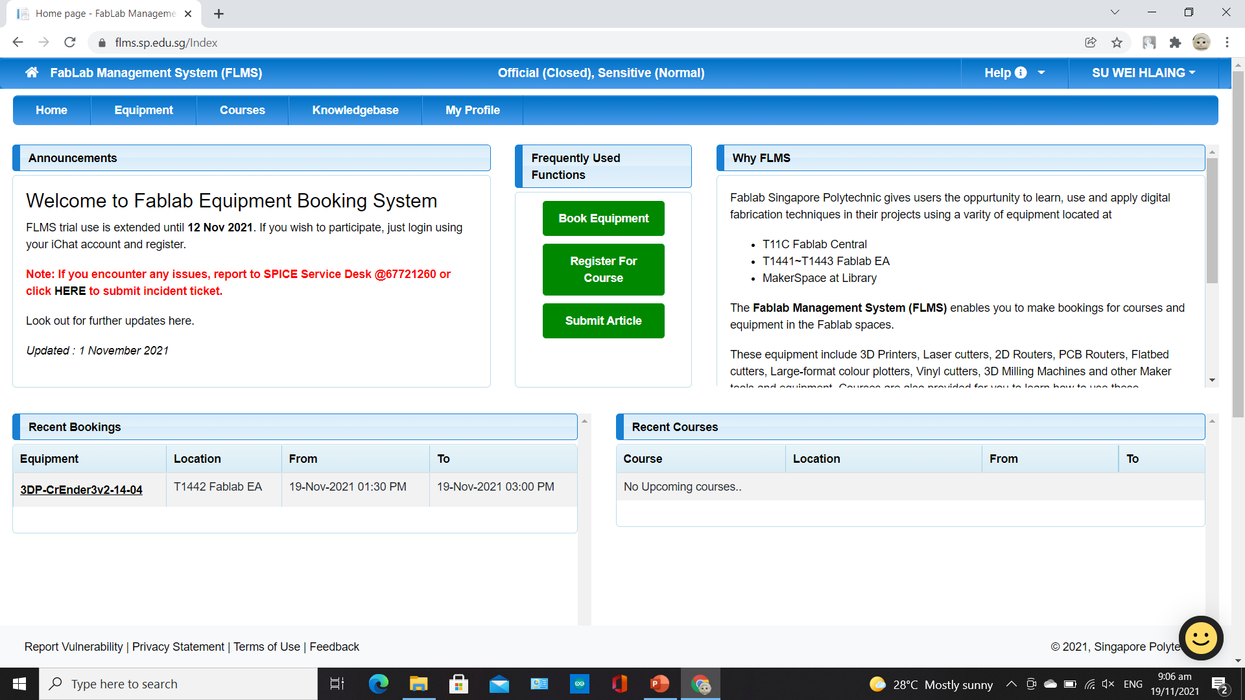
Step 1
At the FLMS homepage, click on the equipment you would like to cancel under “Recent Bookings”.

Slide 18
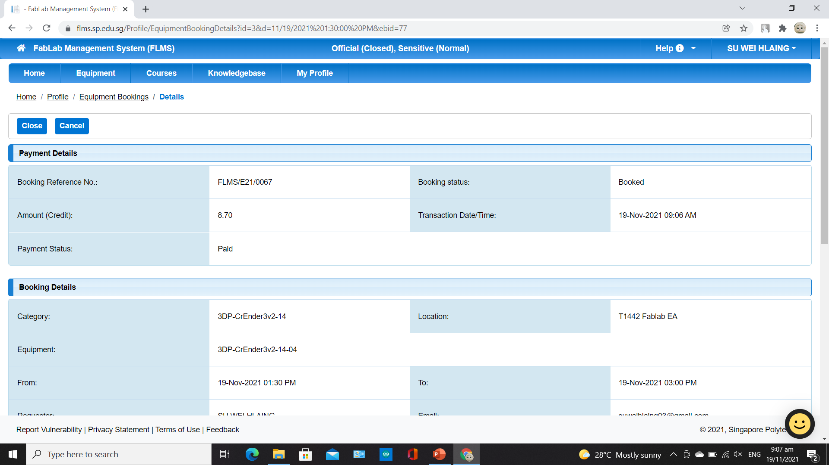
Step 2
You will be directed to your booking details. Click on “Cancel” to cancel your booking schedule.

Slide 19
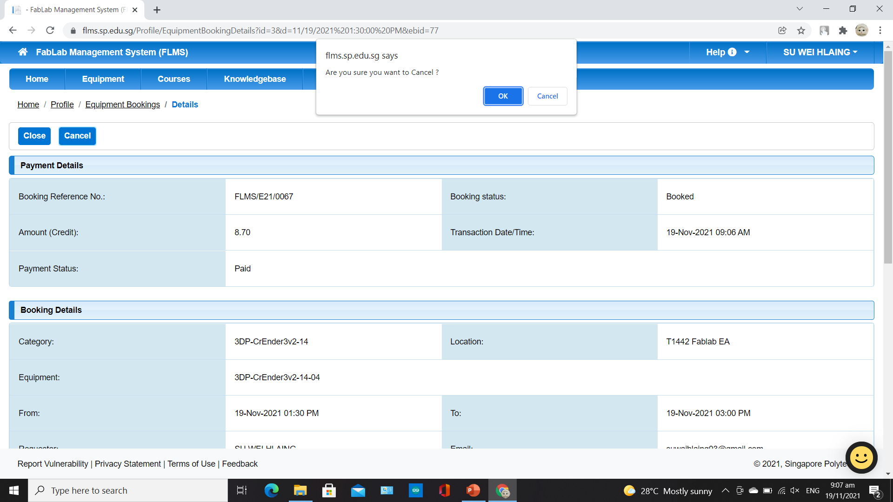
Step 2
A pop-up will appear asking for confirmation. Click “OK” to confirm your cancellation.

Slide 20

Step 3
Now if you look at the home page, the schedule will disappear and it will show “No Upcoming Bookings”.

Slide 21
End of FLMS Guide

